Slide 1

--------------------------
E-COMMERCE APPLICATION ON CLOUD FOUNDRY
TEAM MEMBERS:
RAJAPRIYANKA R (au821321104028)
ALEENSHYLAJA K (au821321104001)
MADESHWARAN K (au821321104016)
SAIRA BEGAM S (au821321104031)
PREETHIKA V (au821321104025)

Slide 2
AGENDA
Home page
App – CSS
Index – CSS
Navbar – CSS
Body – CSS

Slide 3
FRONTEND DEVELOPMENT
Front-end development, often referred to as client-side development, focuses on creating the user interface and user experience (UI/UX) of a website or web application. Front-end developers are responsible for designing and implementing the visual elements of a web application that users interact with directly. This includes the layout, design, interactivity, and functionality of a website or web app.
HTML
CSS
JavaScript

Slide 4
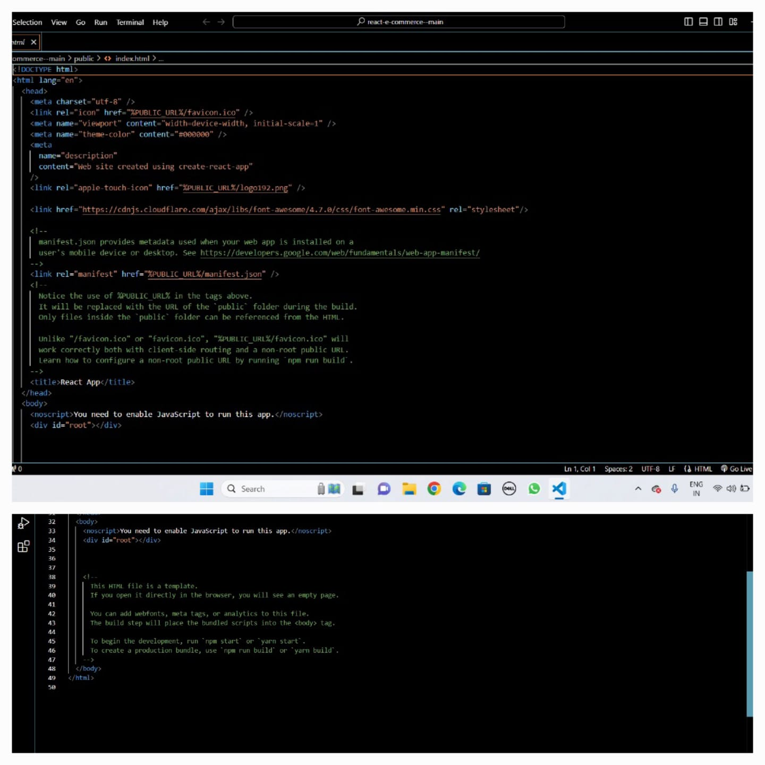
HOMEPAGE
To create homepage for our website we have used Hyper Text Markup Language(HTML)
Snapshot of code:

Slide 5
APP- CSS
To style our webpages in visually appealing ,here we have used Cascading Style Sheets(CSS).
Snapshot of code:

Slide 6
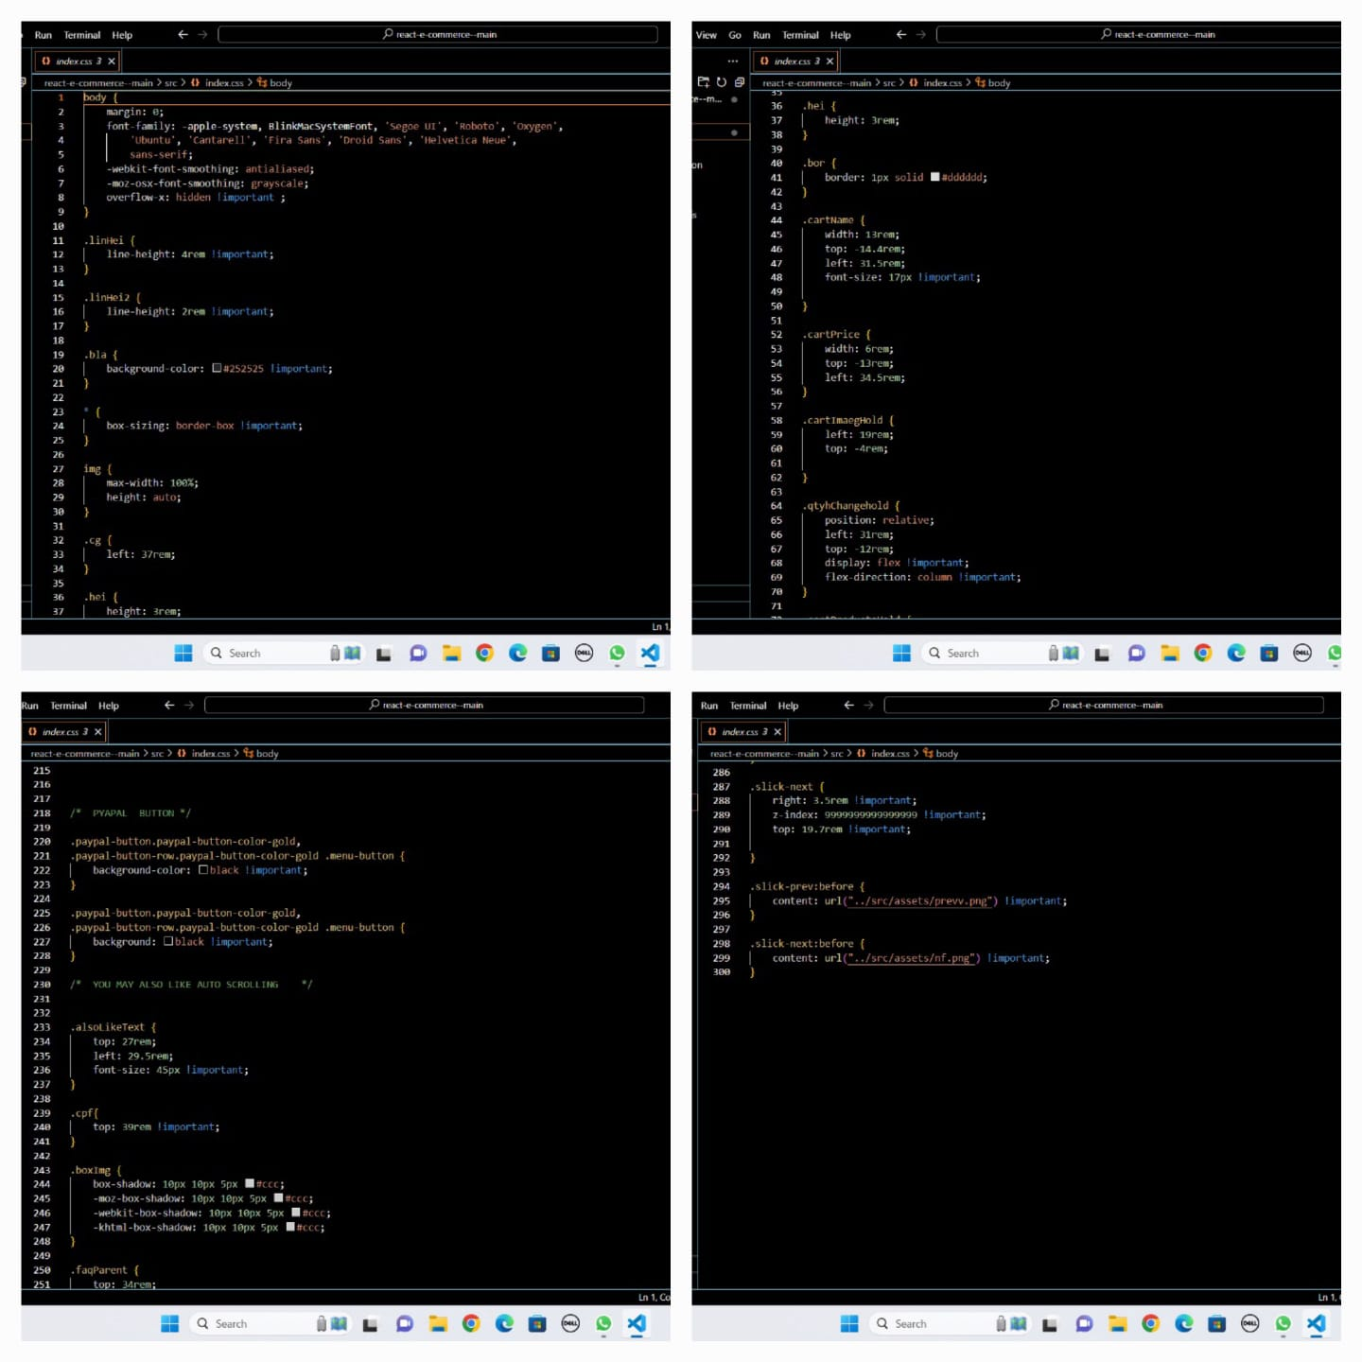
INDEX - CSS
Snapshot of code:

Slide 7
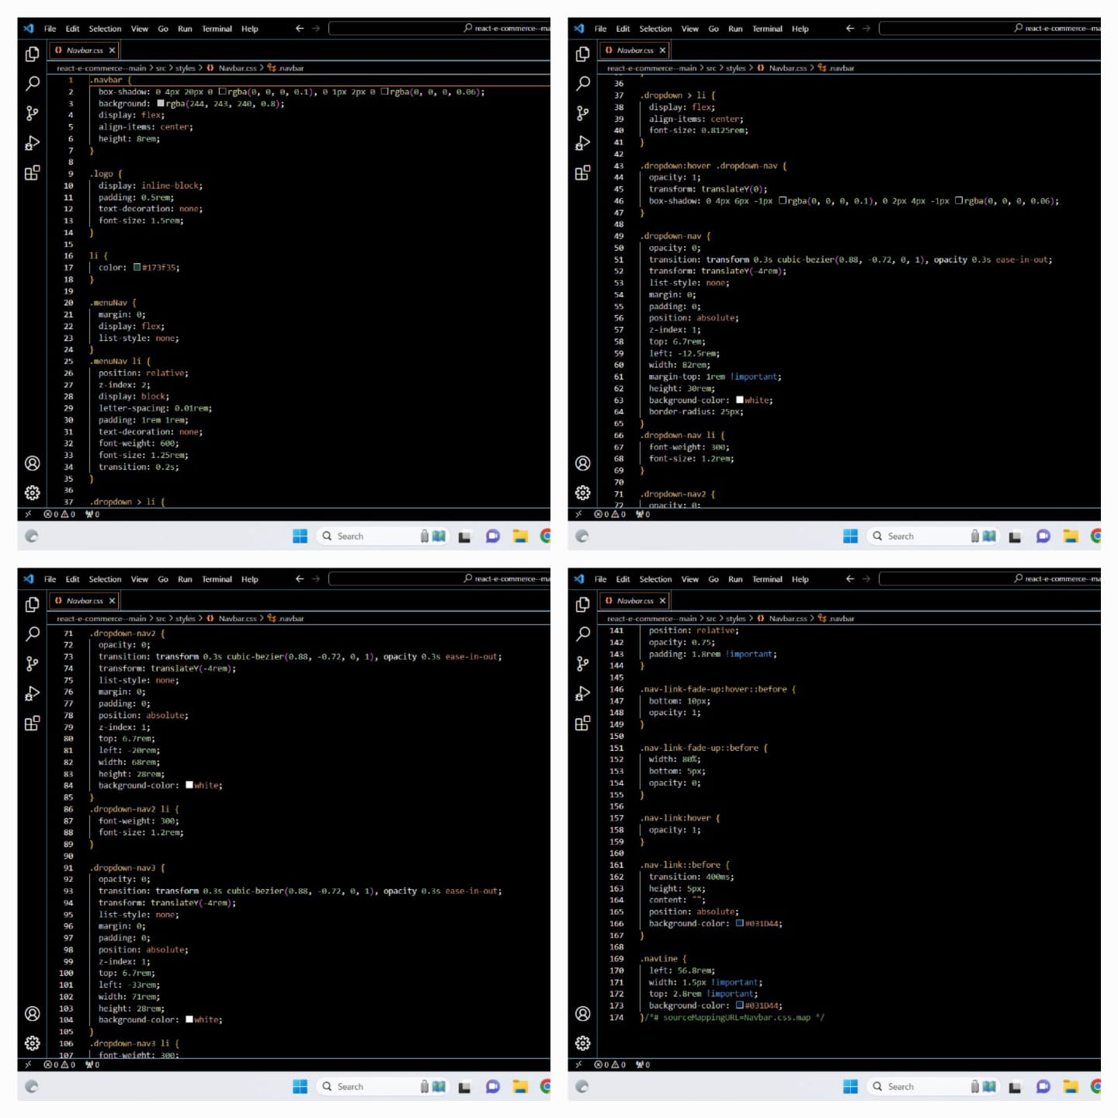
NAVBAR - CSS
Snapshot of code:

Slide 8
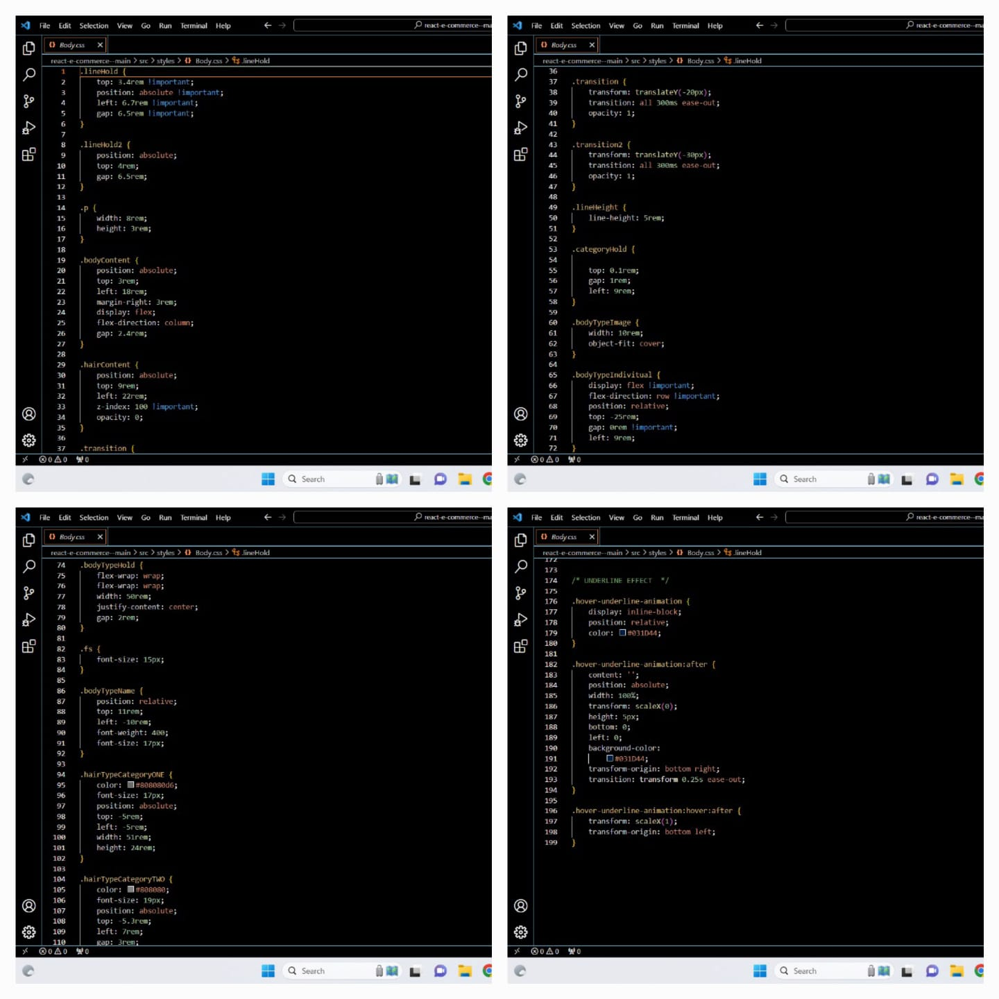
BODY - CSS
Snapshot of code:

Slide 9
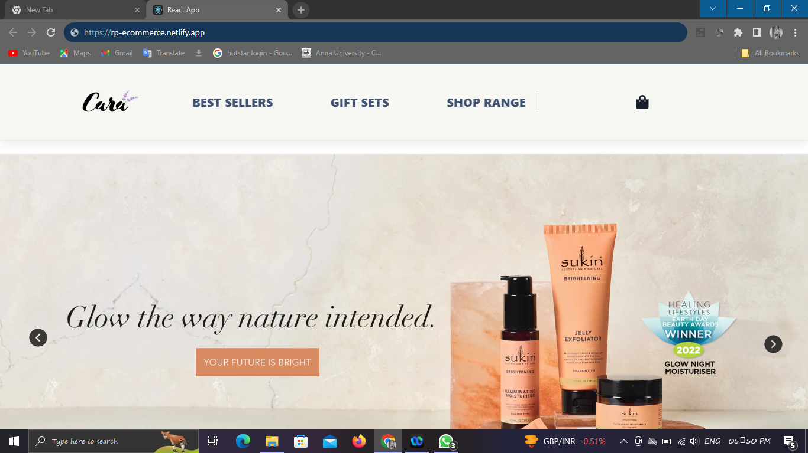
OUTPUT

